Slide 1
02/25/2019
Notes:
<number>

Slide 2
Windows Admin Center
Presented by
Stefan Hirschler
Head of Consulting
stefan.hirschler@moveit-solutions.com
Markus Zierer
CEO
markus.zierer@moveit-solutions.com

Slide 3
Agenda
Part I –Deploying WAC
Prerequisites
Desktop mode vs. gateway mode
Deployment options
Deploying WAC with MoveIT Solutions OneGlass
Part II – Using WAC
Prerequisites for managed devices
Function overview
The Good, the Bad and the Ugly
<number>

Slide 4
Part I – Deploying WAC
What is Windows Admin Center?
“Windows Admin Center is a lightweight, browser-based GUI platform and toolset for IT Admins to manage Windows Server and Windows 10. It's the evolution of familiar in-box administrative tools, such as Server Manager and Microsoft Management Console (MMC) into a modernized, simplified, integrated, and secure experience.”
<number>

Slide 5
Part I – Deploying WAC
Prerequisites
Supported OS:
Windows Server 2016, 2019 and SAC
Windows 10 Version 1709 or newer
Server Core supported
Installation on DC not supported
<number>

Slide 6
Part I – Deploying WAC
Desktop mode vs. gateway mode
Desktop mode
Always used on Windows 10 machine
No external connection to WAC possible
Port has to be higher than 1023
Self signed certificate will be used
No user access options
<number>

Slide 7
Part I – Deploying WAC
Desktop mode vs. gateway mode
Gateway mode
Only on Windows Server 2016/2019/SAC
External connections possible
Valid SSL certificate can (and should be) used
Default SSL port can be use
<number>

Slide 8
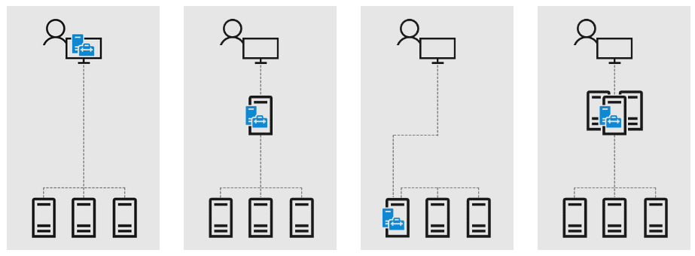
Part I – Deploying WAC
Deployment options
<number>

Slide 9
Part II – Using WAC
What is required to use WAC?
What is the idea behind WAC?
<number>

Slide 10
Use WAC - Requirements
Supported Browsers
Microsoft Edge
Google Chrome
Not supported, but working
Firefox Quantum (60 or newer)
<number>

Slide 11
What is the idea of WAC?
Browser based Administration tool
Lightweight
For local and gateway use
(almost) perfect replacement for a Server GUI -> Admin Tool for Headless Servers
<number>

Slide 12
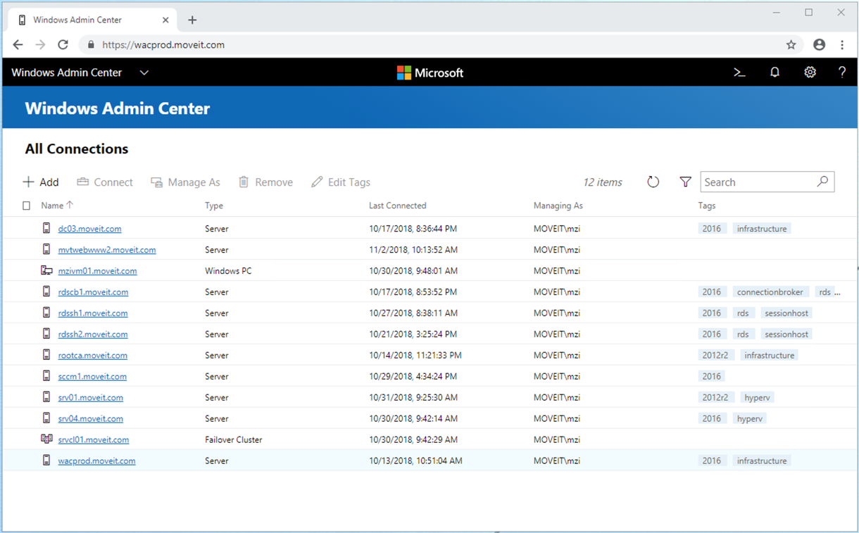
WAC - General Overview
<number>

Slide 13
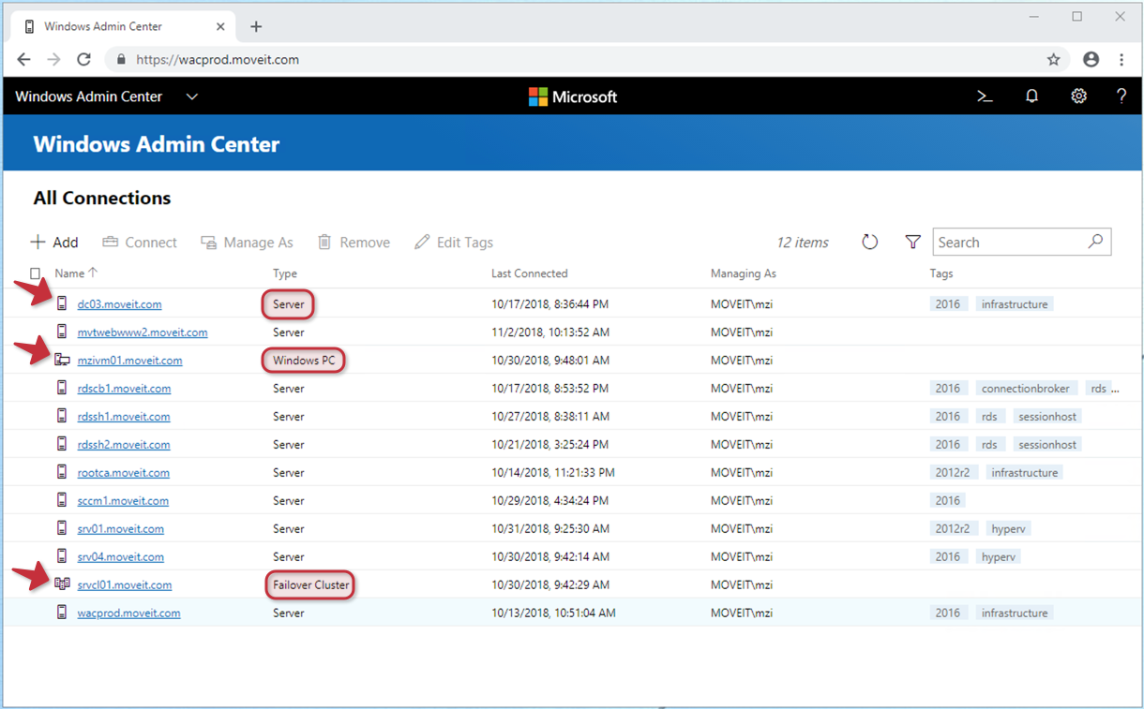
WAC – Different Icons
<number>

Slide 14
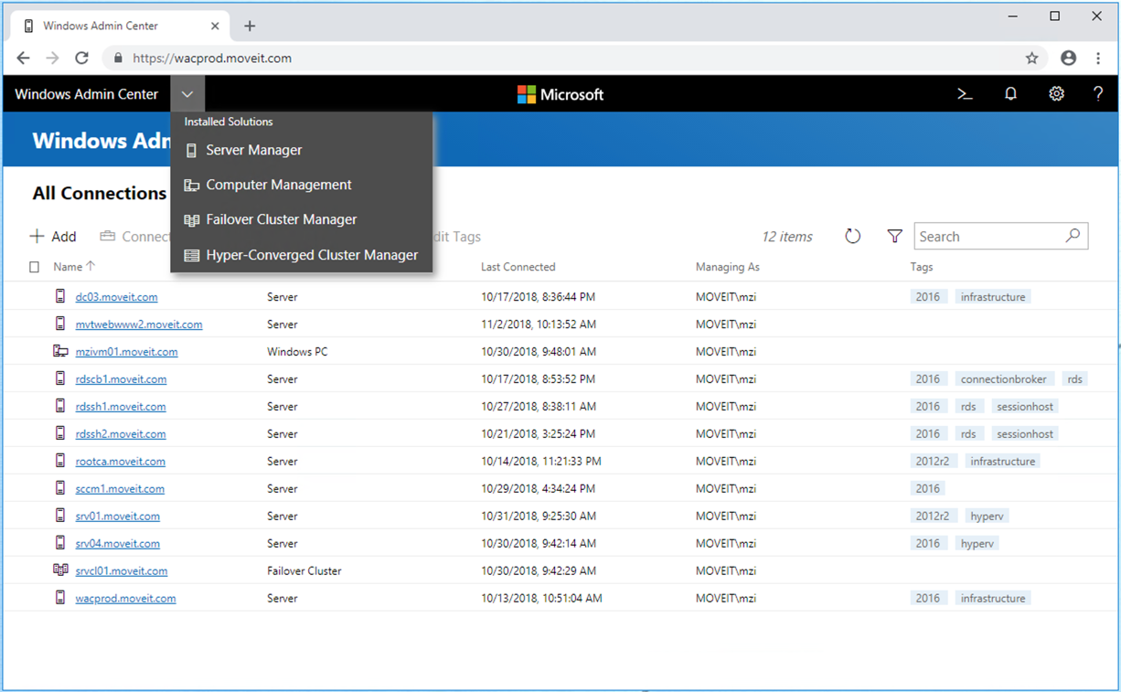
WAC - Views
<number>

Slide 15
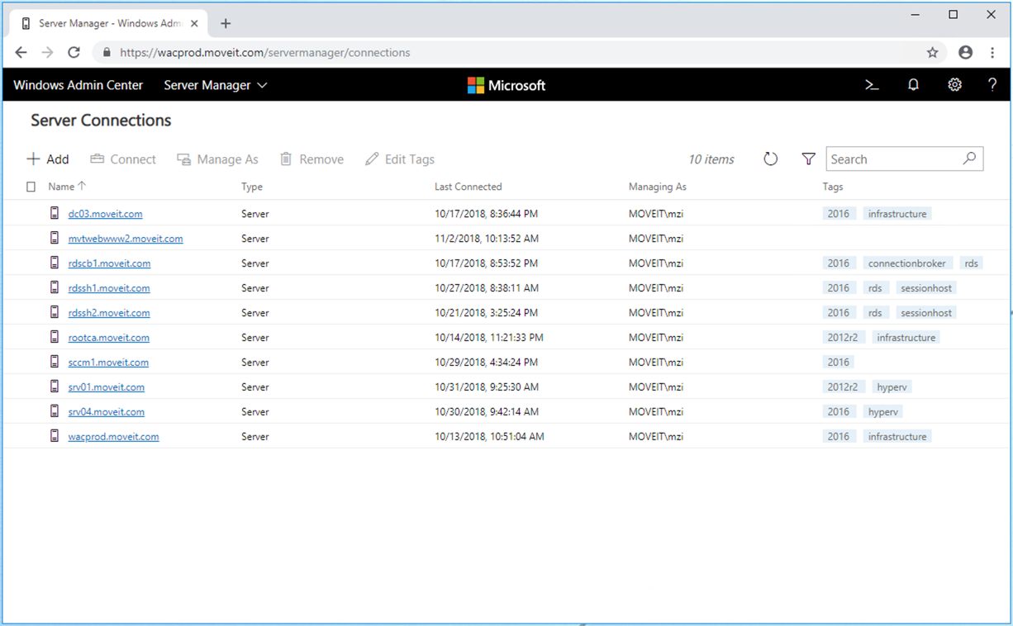
WAC - Views
<number>

Slide 16
WAC - Views - Summary
4 Cateogories for Systems
Servers
Clients
Failover Cluster
Hyper-Converged Cluster
Can be filtered by category
Server Manager
Computer Management
Failover Cluster Manager
Hyper-Converged Cluster Manager
<number>

Slide 17
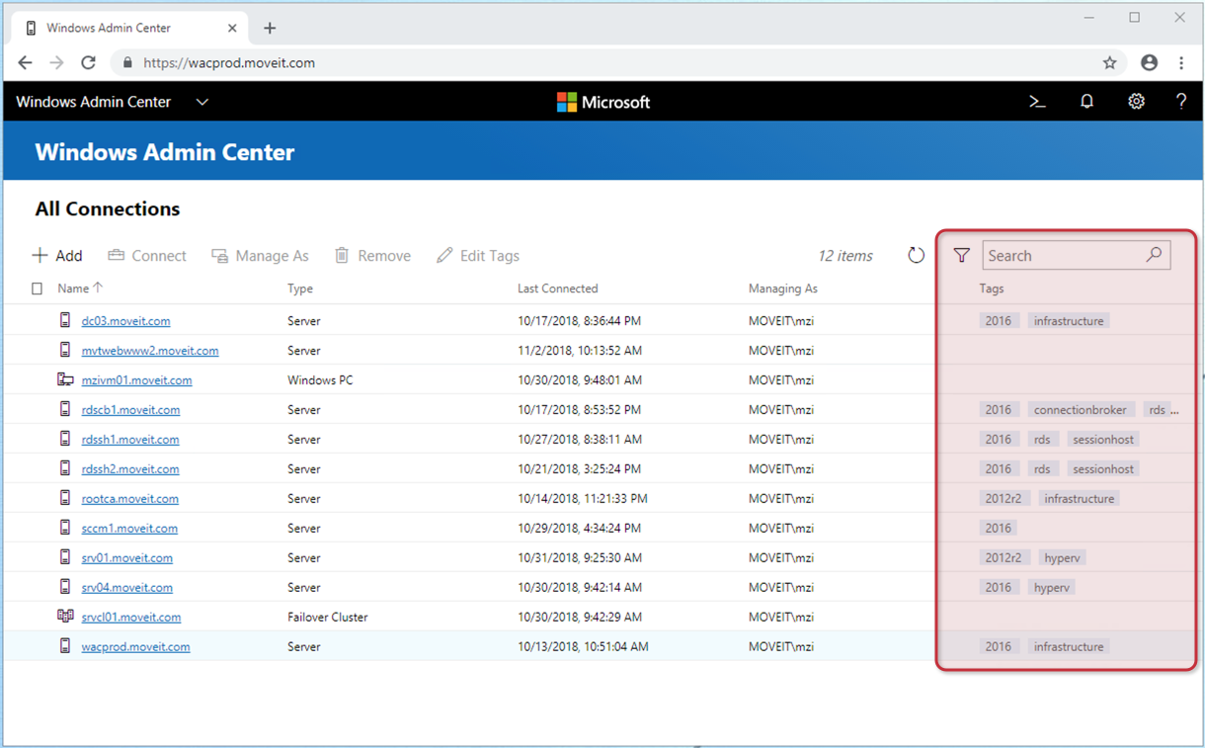
WAC - Tags
<number>

Slide 18
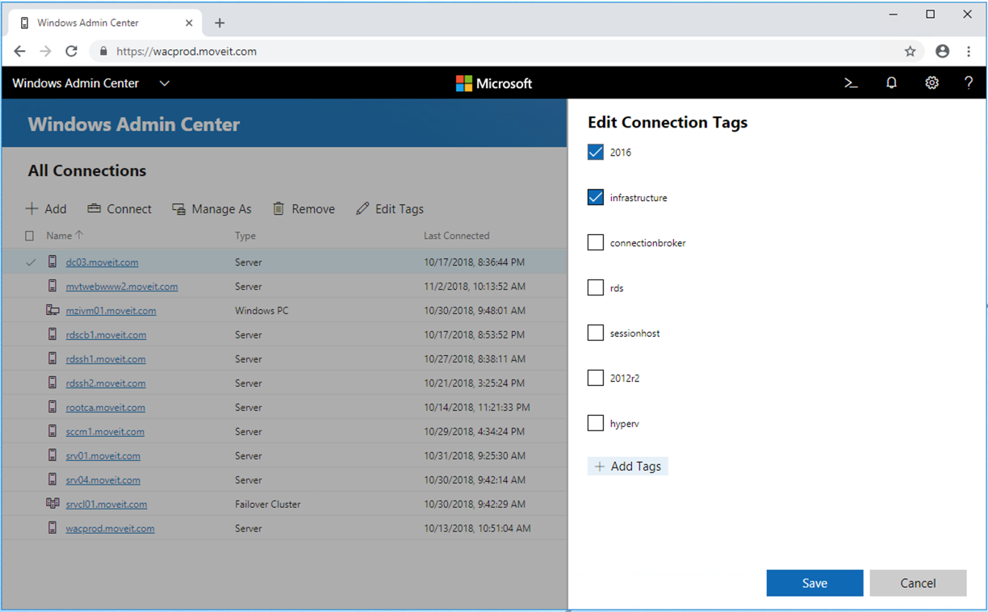
WAC - Tags
<number>

Slide 19
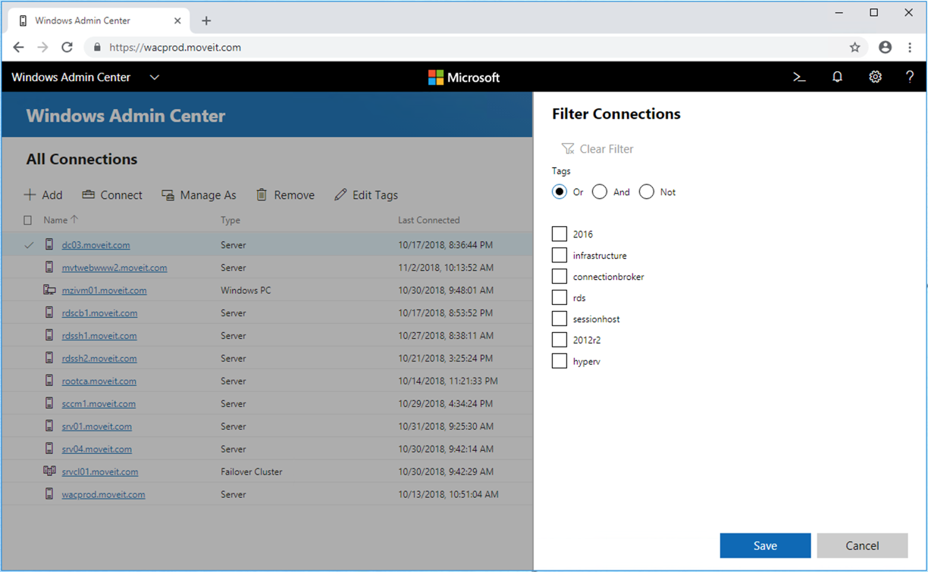
WAC - Tags
<number>

Slide 20
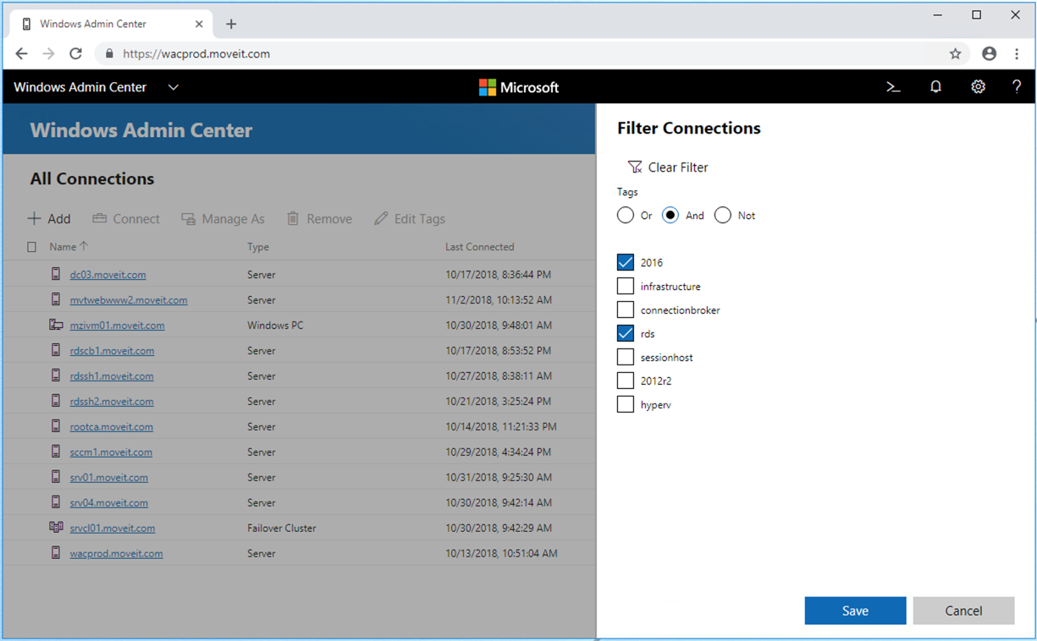
WAC - Tags
<number>

Slide 21
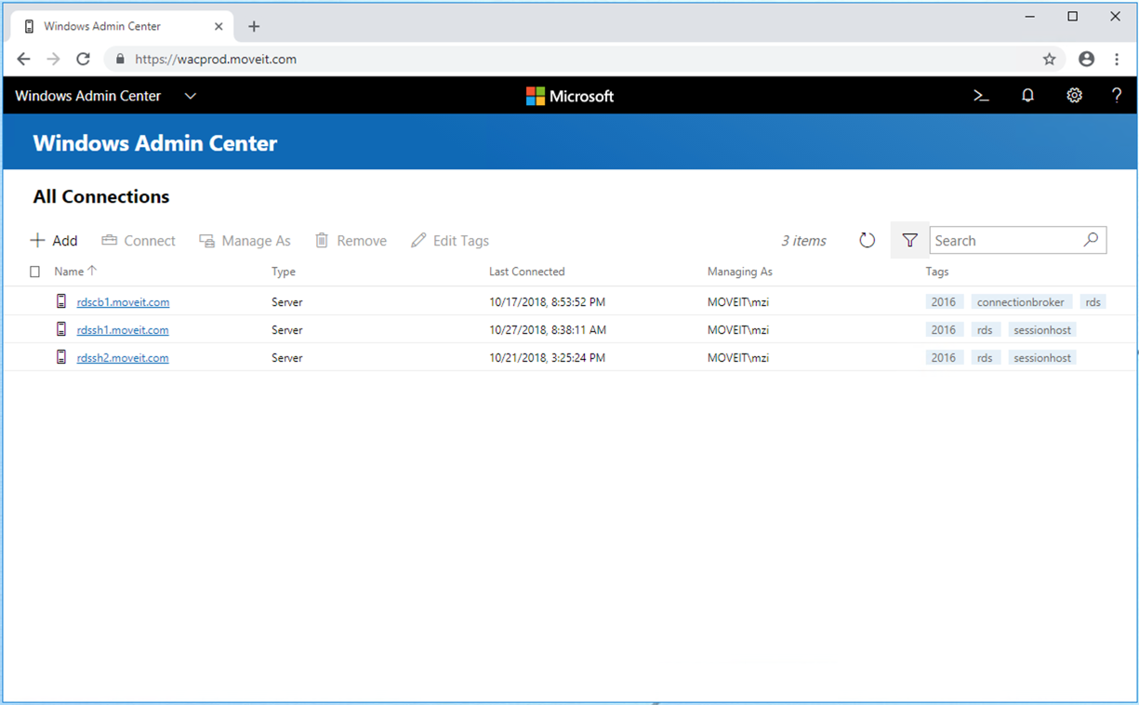
WAC - Tags
<number>

Slide 22
WAC – Tags - Summary
Tags can be used for organizing
Condition based filtering
OR
AND
NOT
<number>

Slide 23
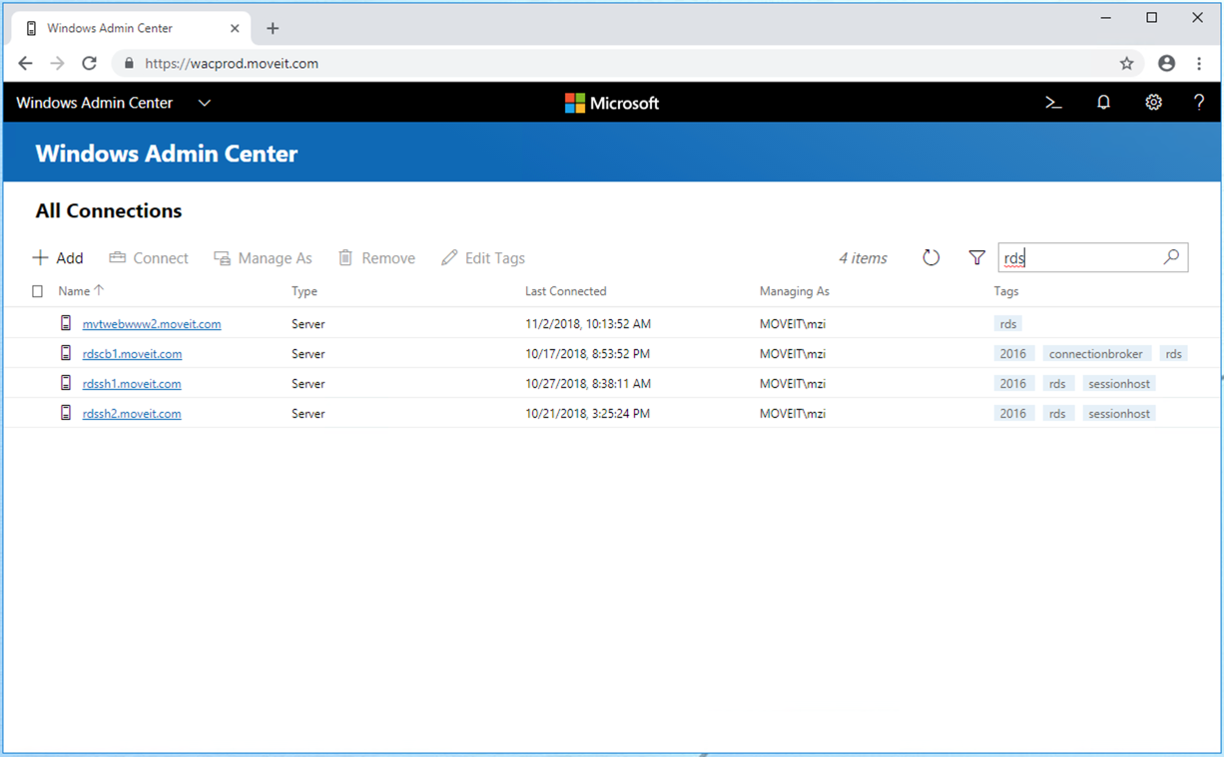
WAC - Search
<number>

Slide 24
WAC – Search - Summary
Fulltext search
Search in Fields
Name
Tags
<number>

Slide 25
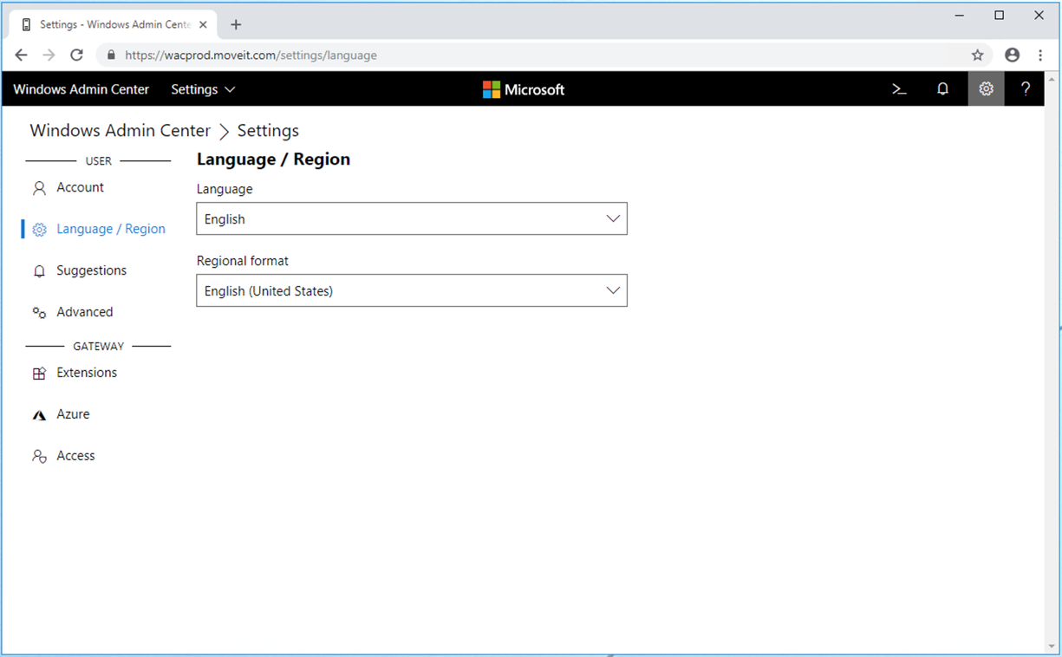
WAC - Settings
<number>

Slide 26
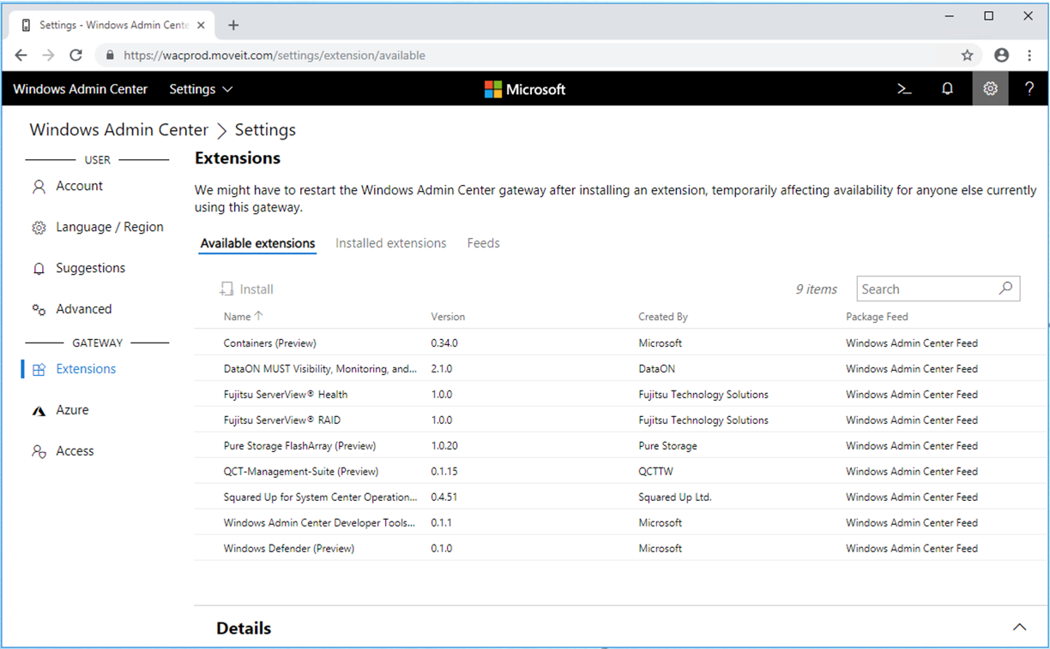
WAC – Extensions
<number>

Slide 27
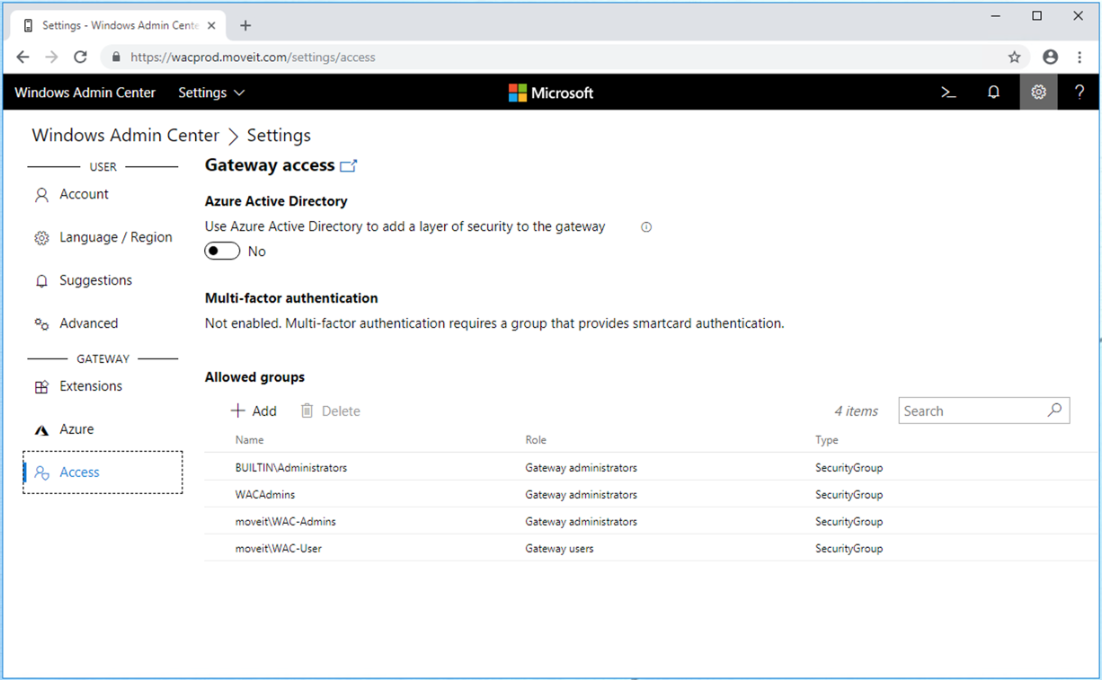
WAC – Gateway Access
<number>

Slide 28
WAC – Settings - Summary
Set language
Configure AzureAD integrations
Configure Access Rights
Install/Uninstall Extensions
<number>

Slide 29
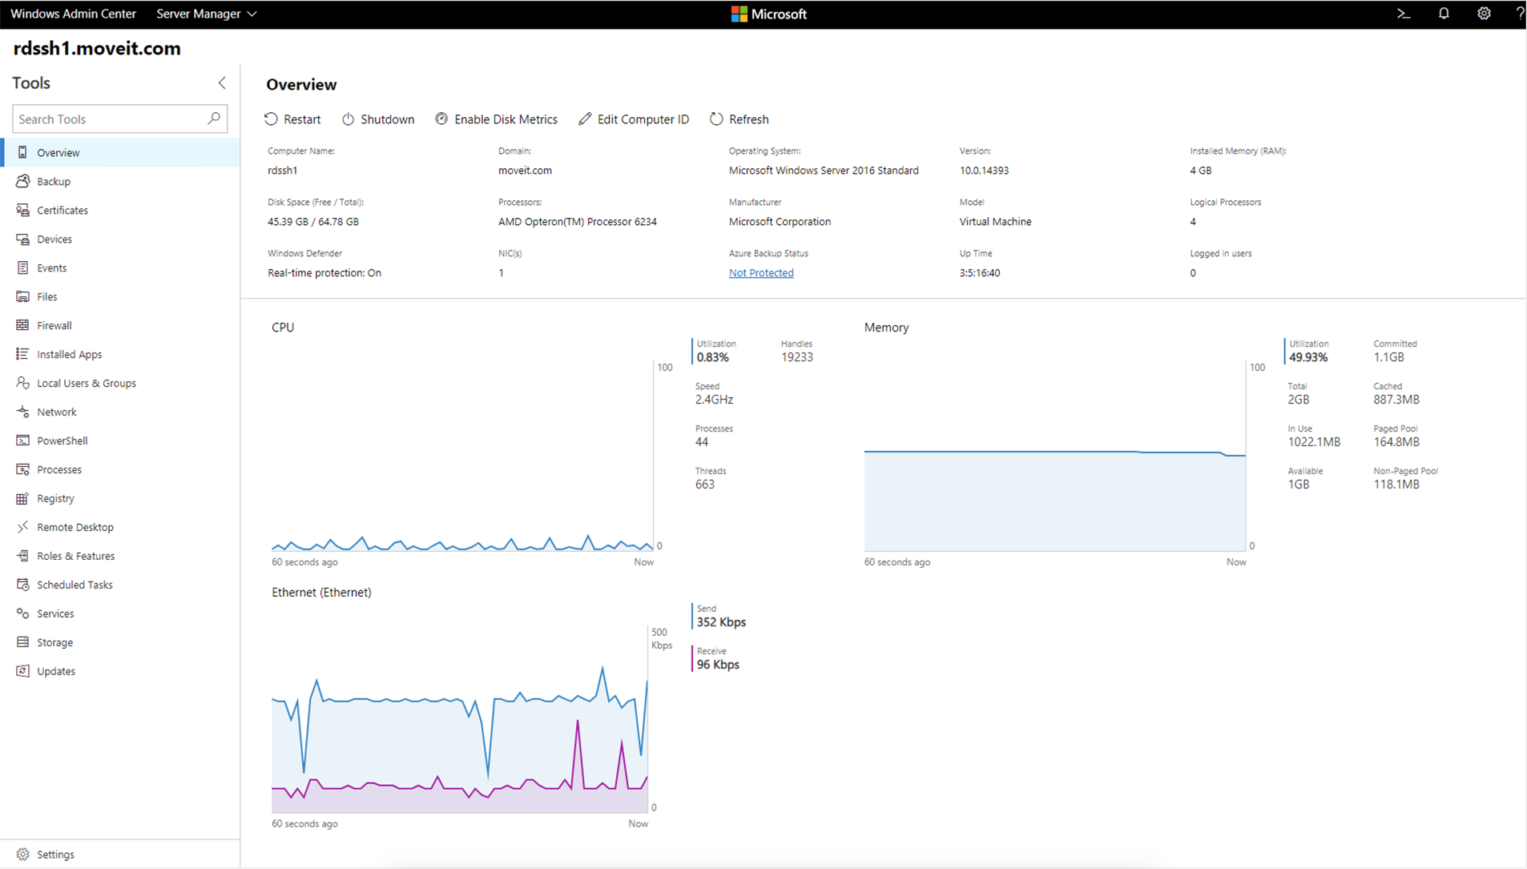
WAC – Server Overview
<number>
Notes:
<number>

Slide 30
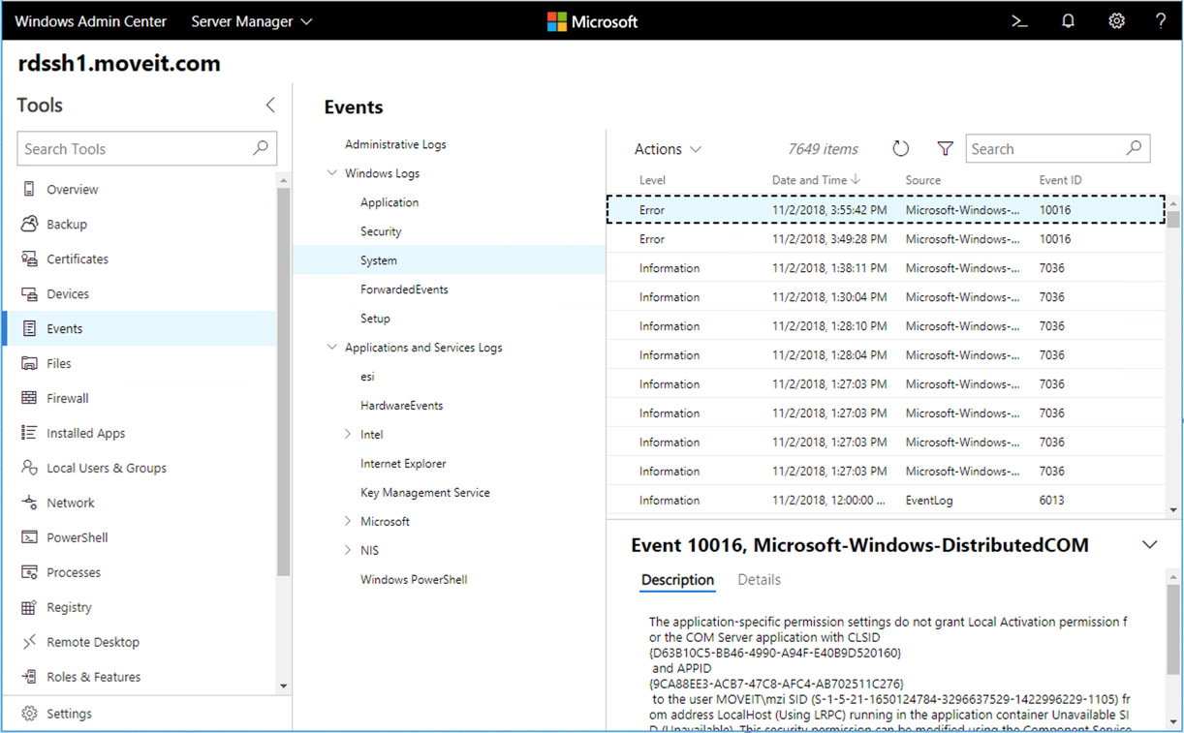
WAC - Event Logs
<number>

Slide 31
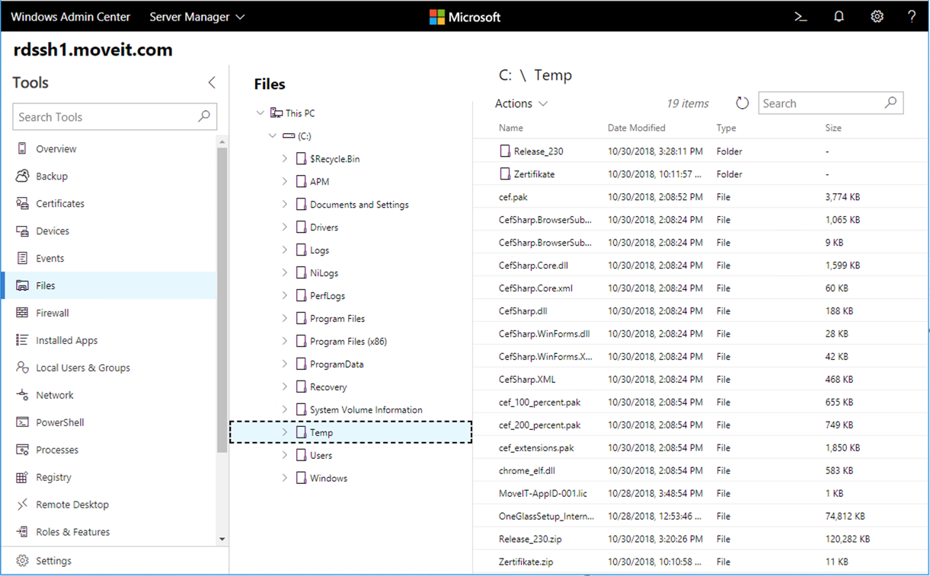
WAC – File Browser
<number>

Slide 32
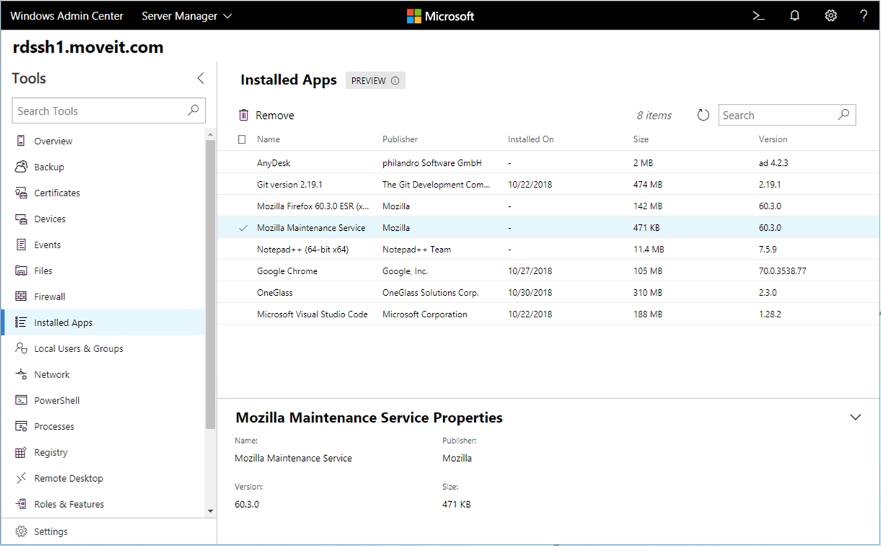
WAC – Installed Apps
<number>

Slide 33
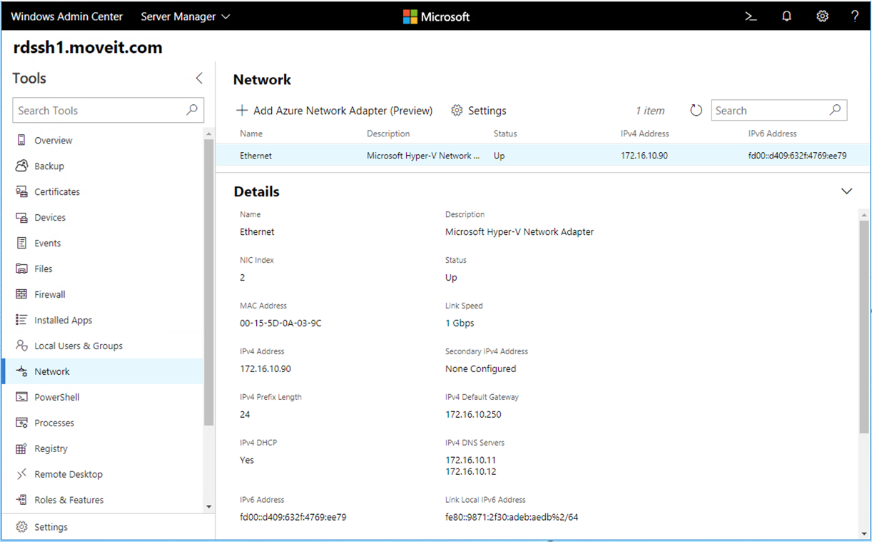
WAC – Network Adapters
<number>

Slide 34
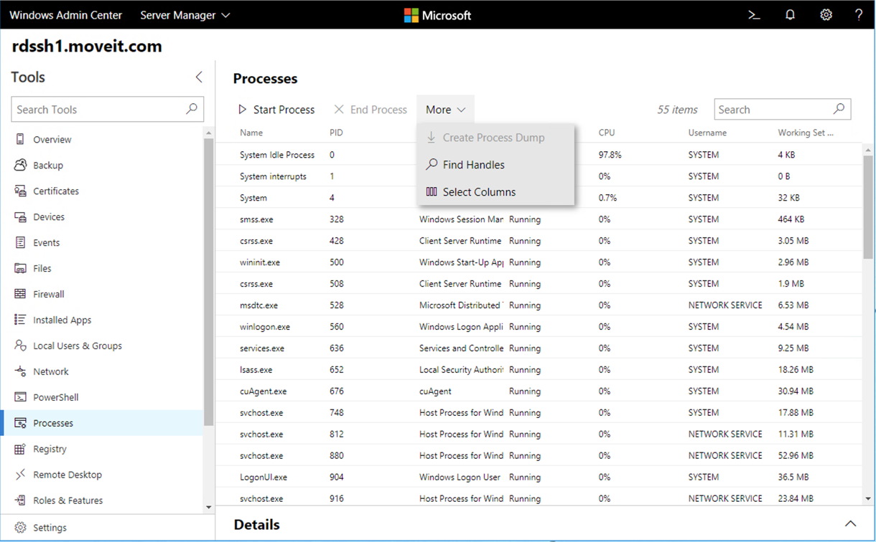
WAC – Process View
<number>

Slide 35
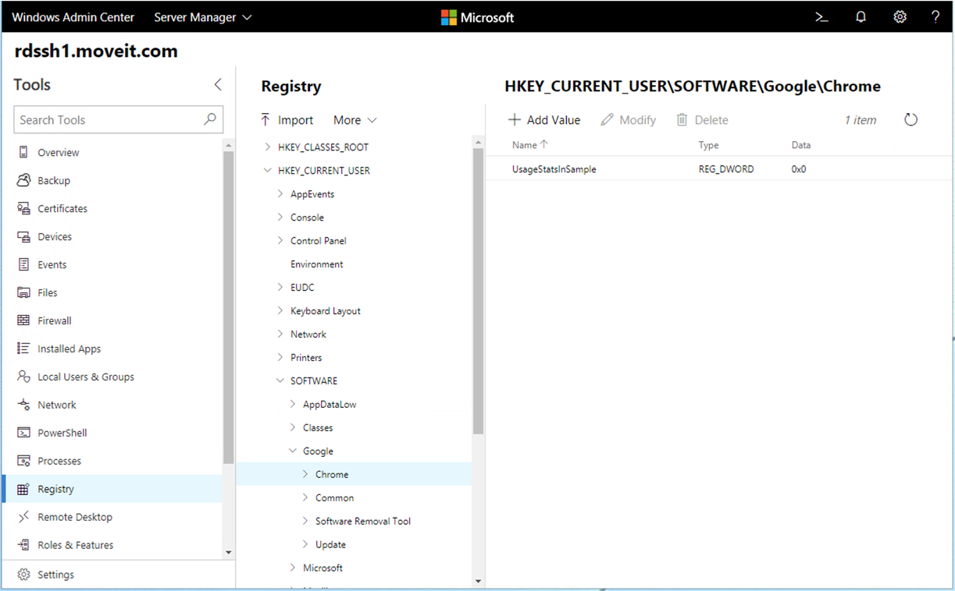
WAC – Registry View
<number>

Slide 36
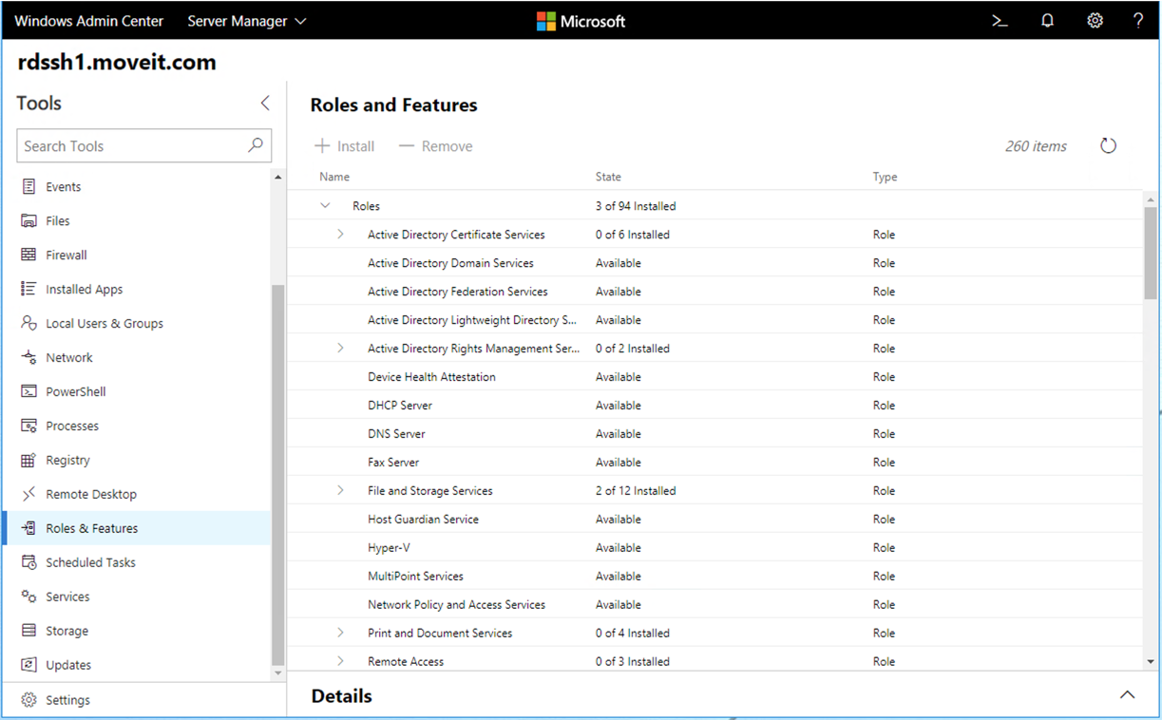
WAC - Features
<number>

Slide 37
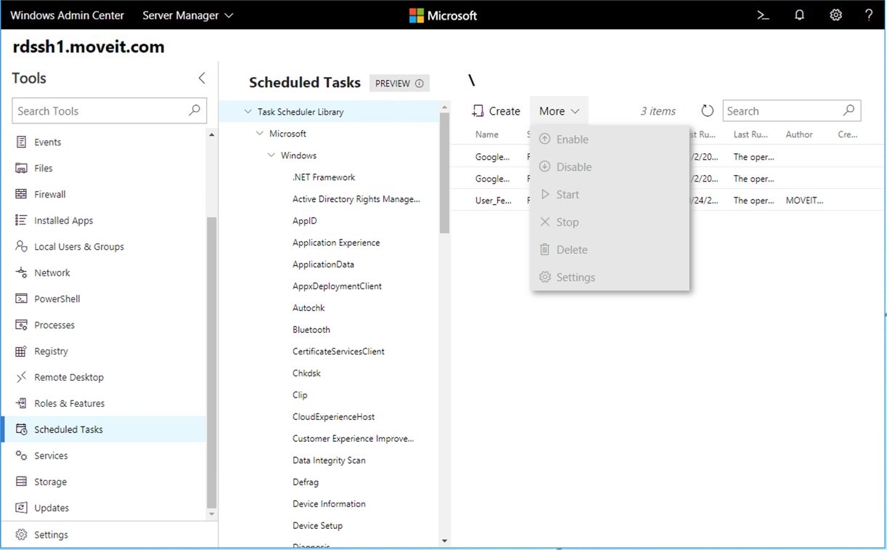
WAC – Task Scheduler
<number>

Slide 38
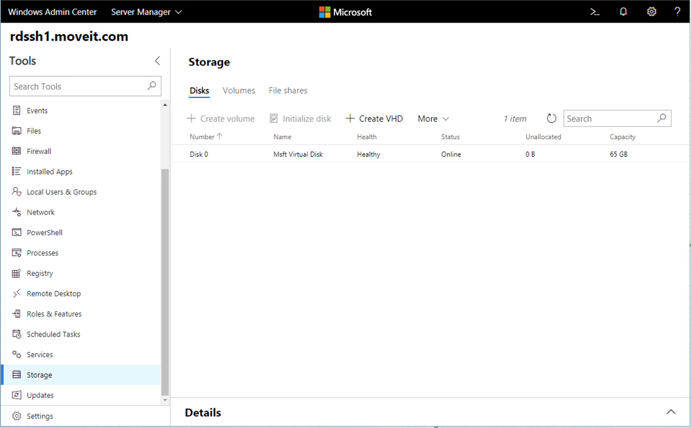
WAC - Storage
<number>

Slide 39
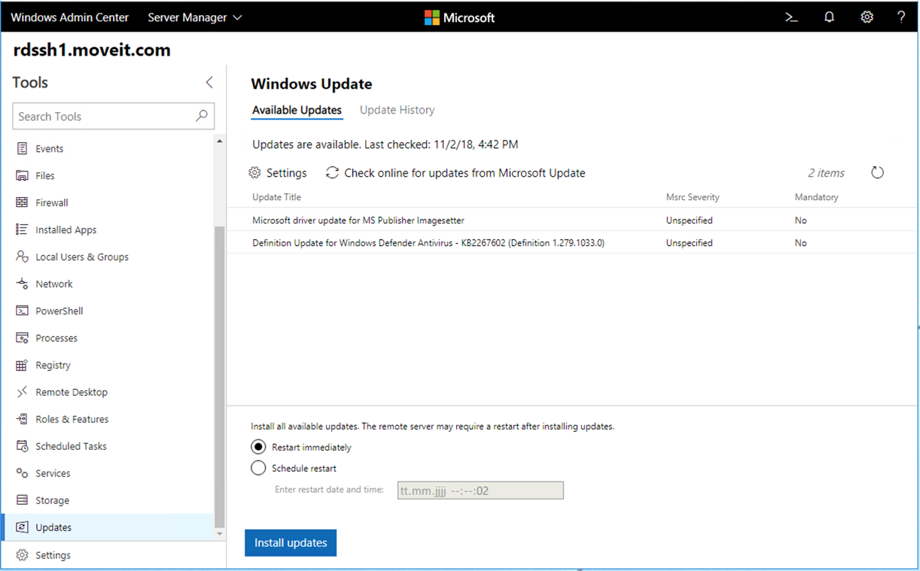
WAC - Updates
<number>

Slide 40
WAC - Updates
No more RDP hopping for patching servers
Install & Reboot can be scheduled
<number>

Slide 41
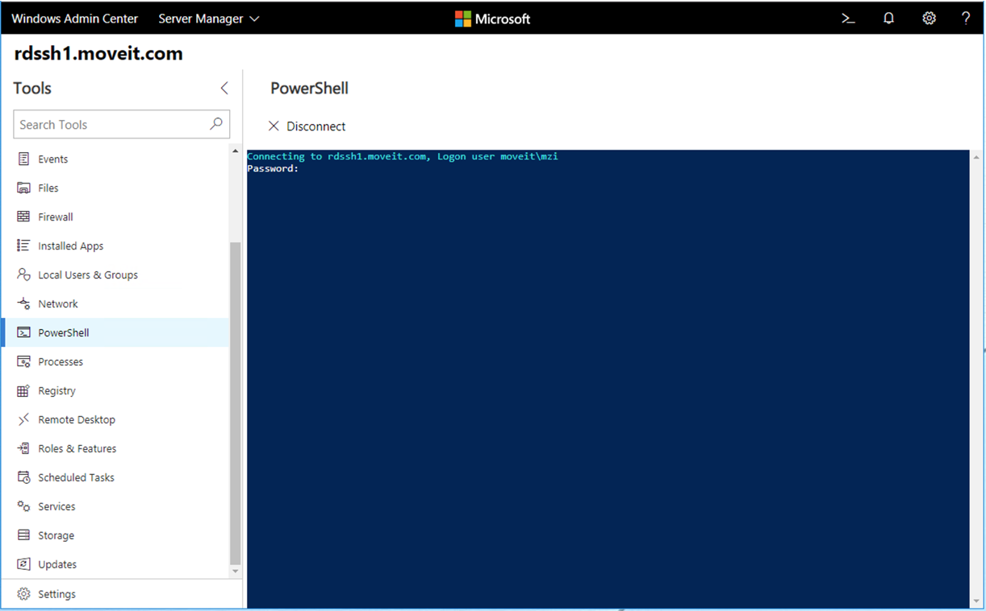
WAC - PowerShell
<number>

Slide 42
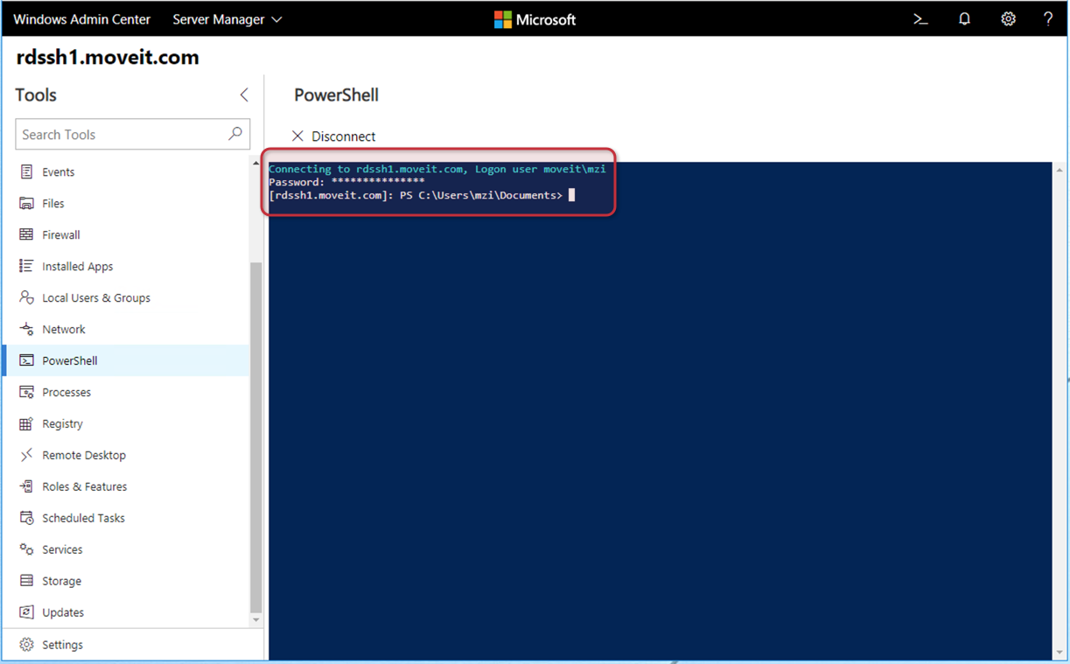
WAC - PowerShell
<number>

Slide 43
WAC - PowerShell
Very useful for
Troubleshooting
Quick configuration
Avoids also RDP hopping
Avoids having an Admin machine in the target network
<number>

Slide 44
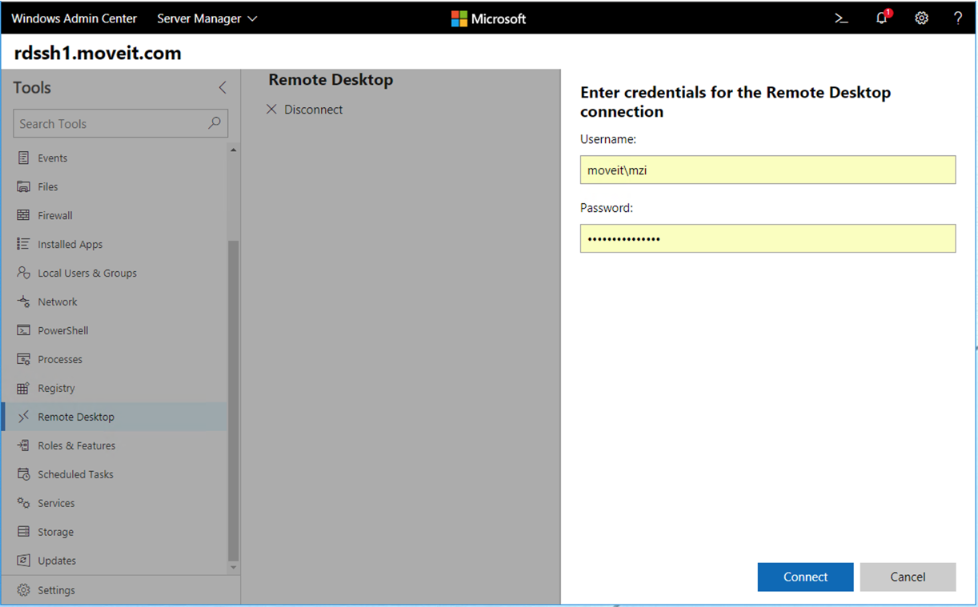
WAC – Remote Desktop
<number>

Slide 45
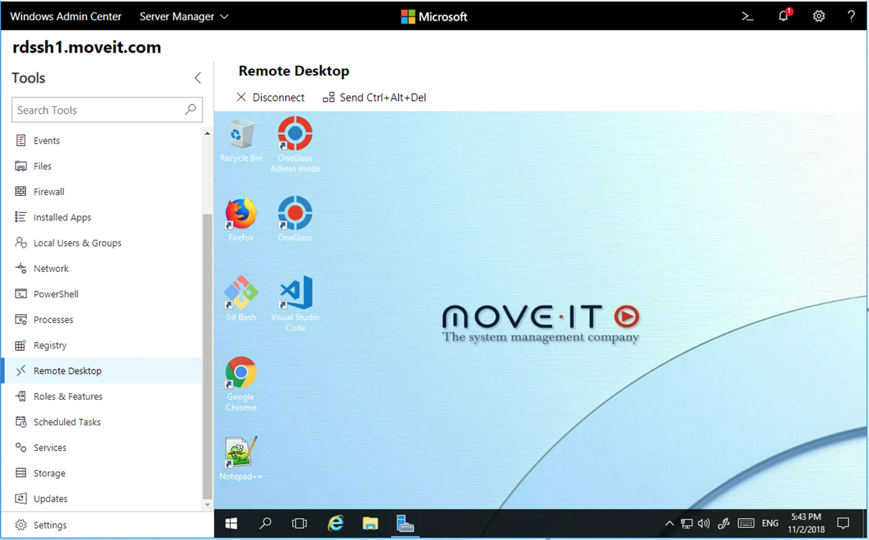
WAC – Remote Desktop
<number>

Slide 46
WAC – Remote Desktop
HTML5 based RDP Client
Almost no features, just pure RDP ;-)
Also avoids Admin machines or complex dial in solutions
<number>

Slide 47
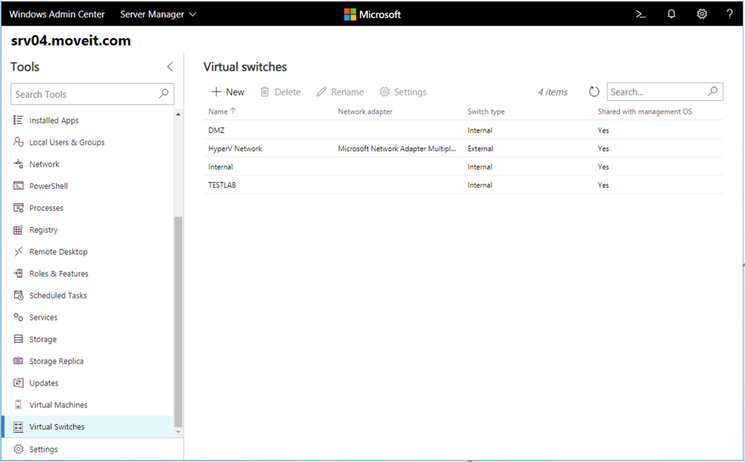
WAC – Virtual Switches
<number>

Slide 48
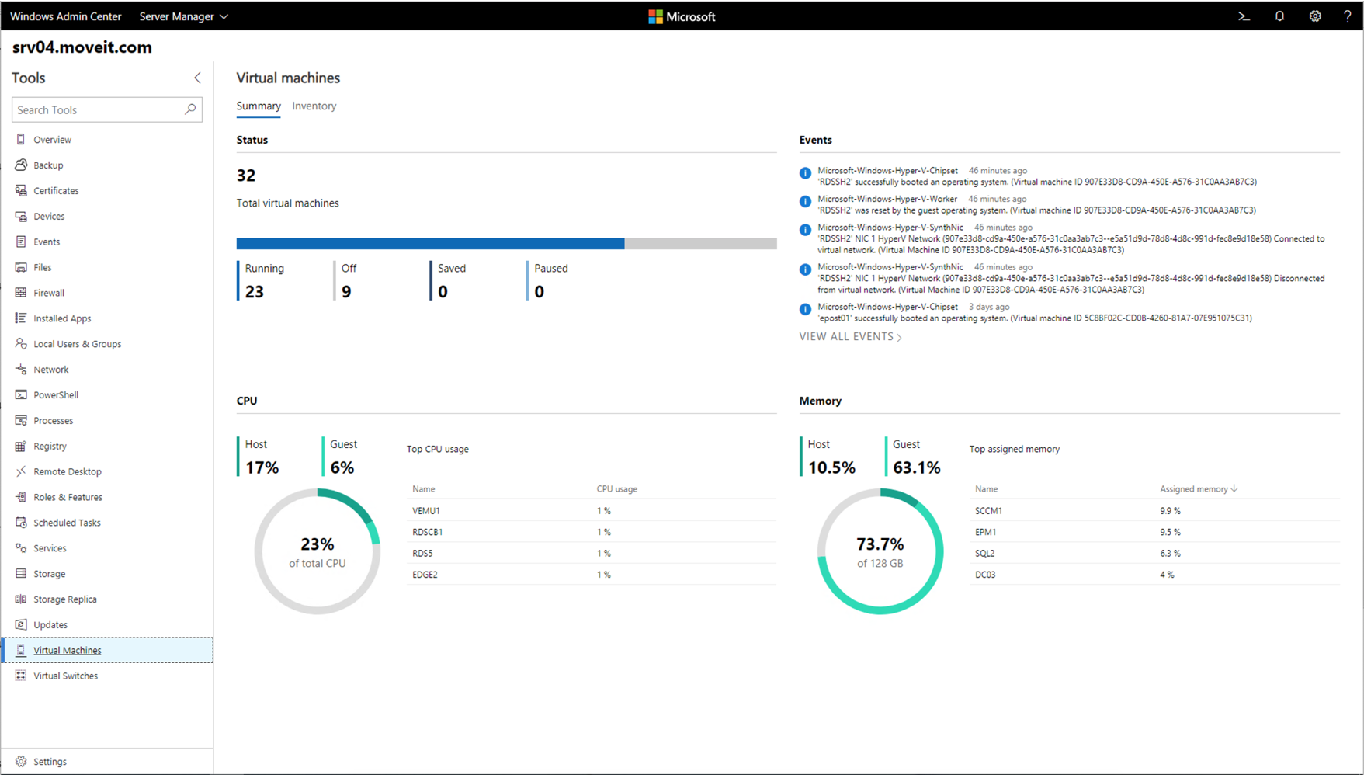
WAC – HyperV - Summary
<number>

Slide 49
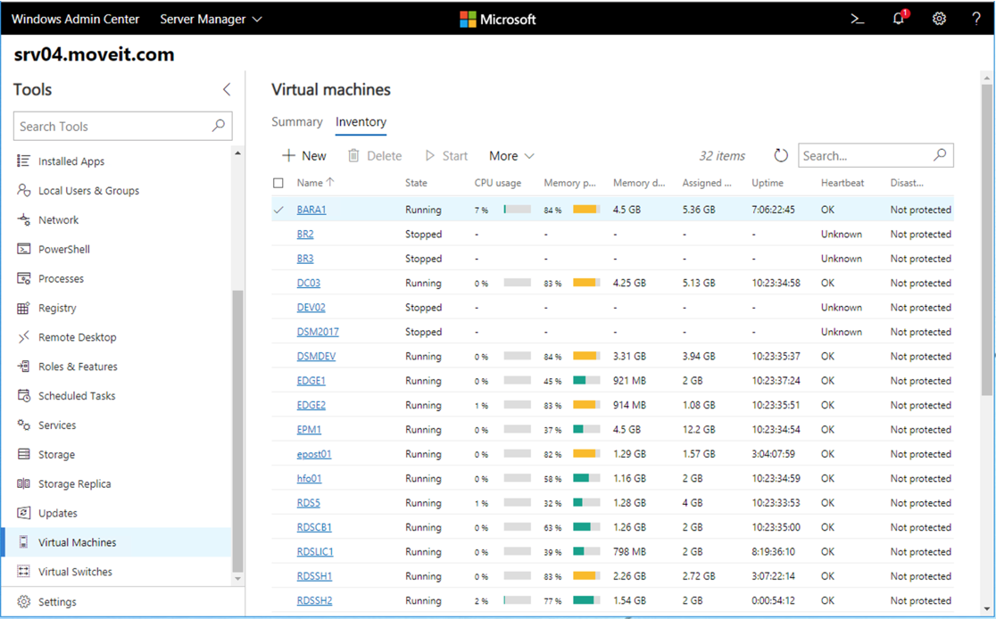
WAC – HyperV - Inventory
<number>

Slide 50
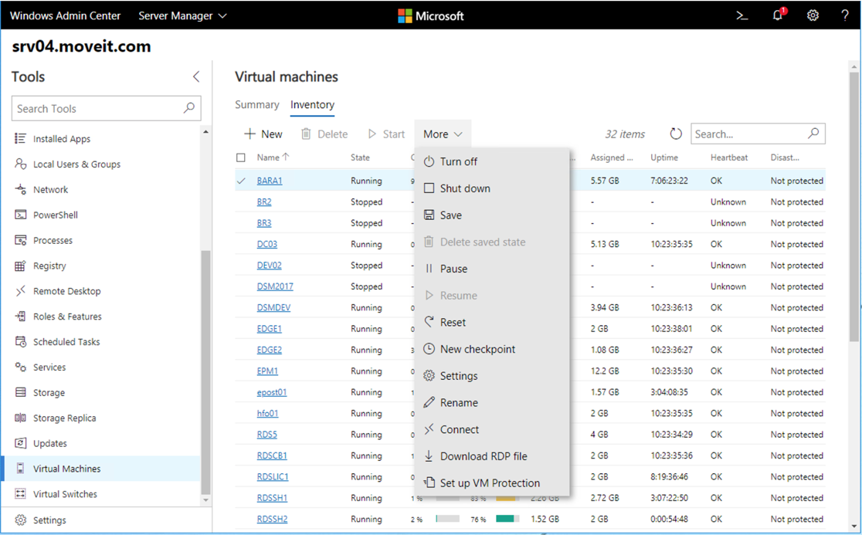
WAC – HyperV - Inventory
<number>

Slide 51
WAC – HyperV - Inventory
Very cool way of managing your Hyper-V machines
<number>

Slide 52
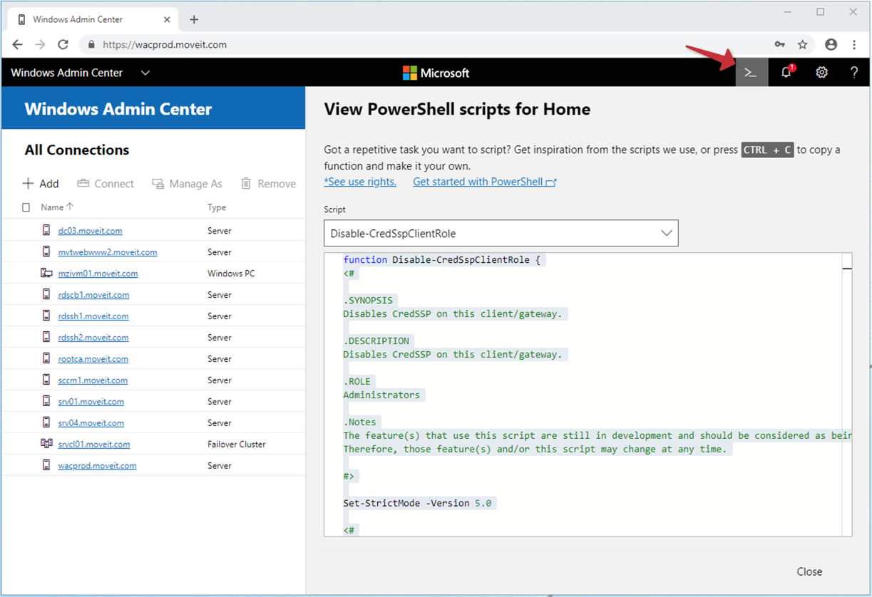
WAC – PoSh Scripts
<number>

Slide 53
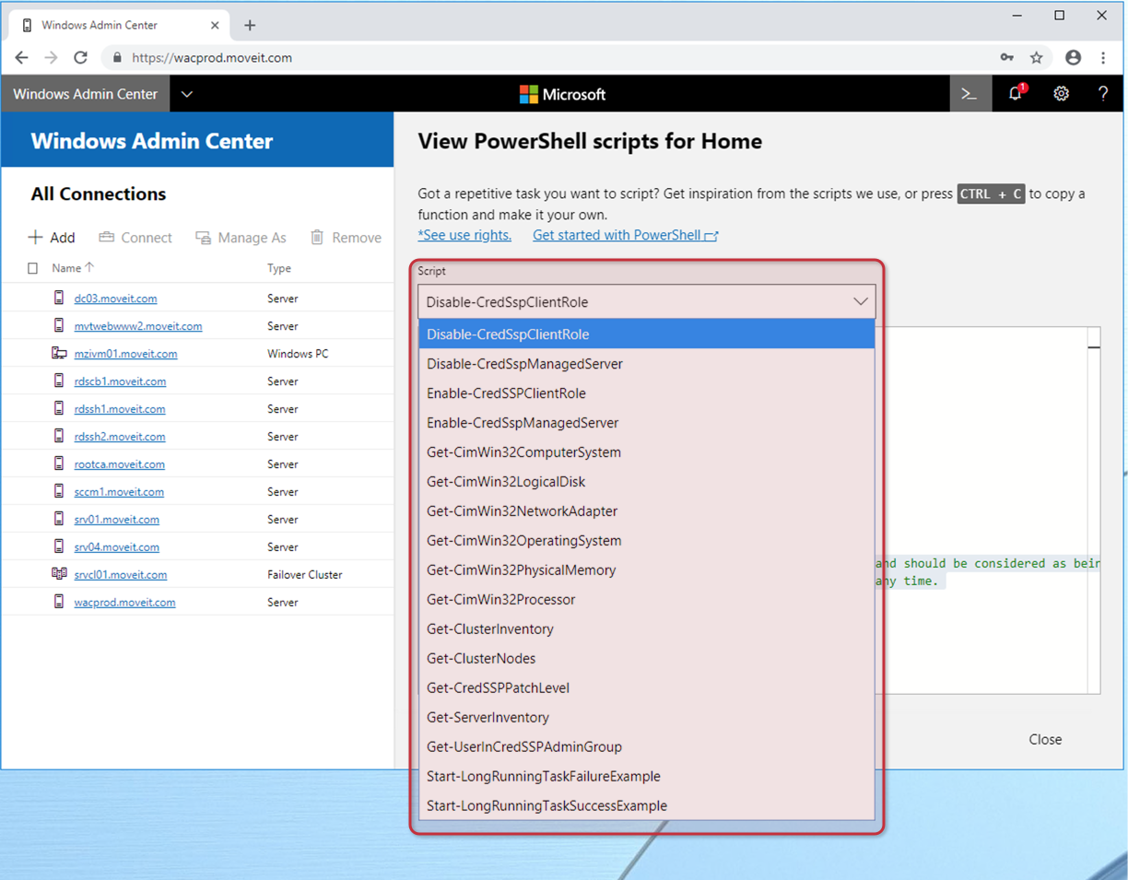
WAC – PoSh Scripts
<number>

Slide 54
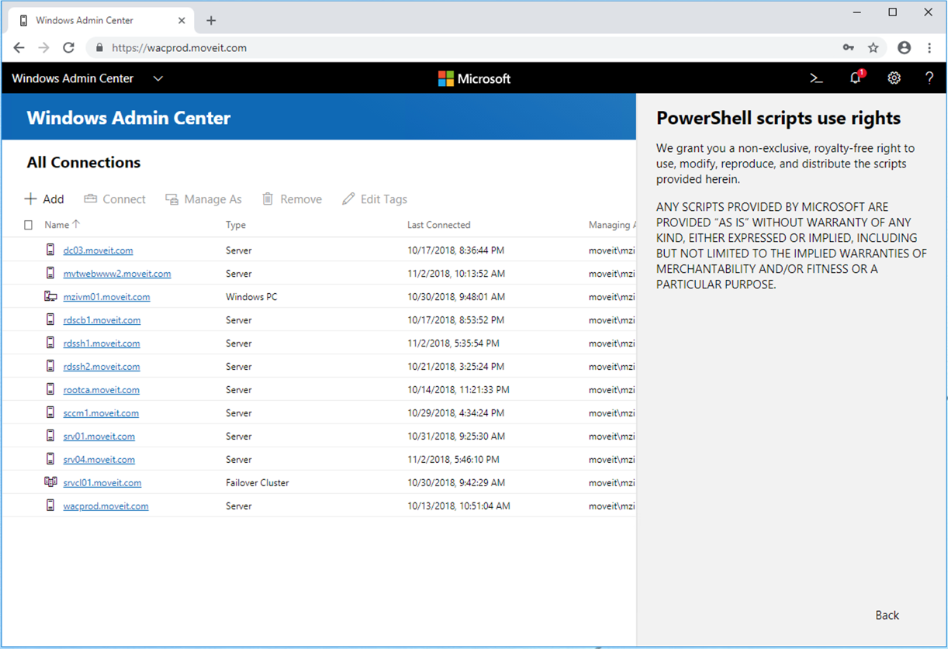
WAC – PoSh Scripts
<number>
Notes:
<number>

Slide 55
WAC – PoSh Scripts
PowerShell script use rights
„We grant you a non-exclusive, royalty-free right to use, modify, reproduce, and distribute the scripts provided herein.“
- Thank you Microsoft!
<number>
Notes:
<number>

Slide 56
WAC – PoSh Scripts - Summary
Available since Preview 1806
Access to ALL the used scripts
Free to use, reengineer, redistribute without costs
<number>

Slide 57

<number>

Slide 58
WAC – The good
Agentless
Extensible
Nice modern UI
Easy to use
Already good functionality
Access to all powershell scripts
<number>

Slide 59
WAC – The bad
No grouping, only tags
Credentials are only saved for the session
A lot of timeouts
Service craches just randomly
No fast switching between systems, no tabbed view inside windows admin center (but you can use browser tabs)
Remotedesktop can be tricky
Update via Windows Update used self signed certificate instead of assigned ssl certificate
<number>

Slide 60
WAC – The ugly
No central management of servers or tags
No importing from DC
Everything is stored in an ESE Database
<number>

Slide 61
Any questions?
<number>

Slide 62
Windows Admin Center
Presented by
Stefan Hirschler
Head of Consulting
stefan.hirschler@moveit-solutions.com
Markus Zierer
CEO
markus.zierer@moveit-solutions.com

